Slide 1

capstone PROJECT
BY: Dillon MAY & gRACE MWANGI

Slide 2
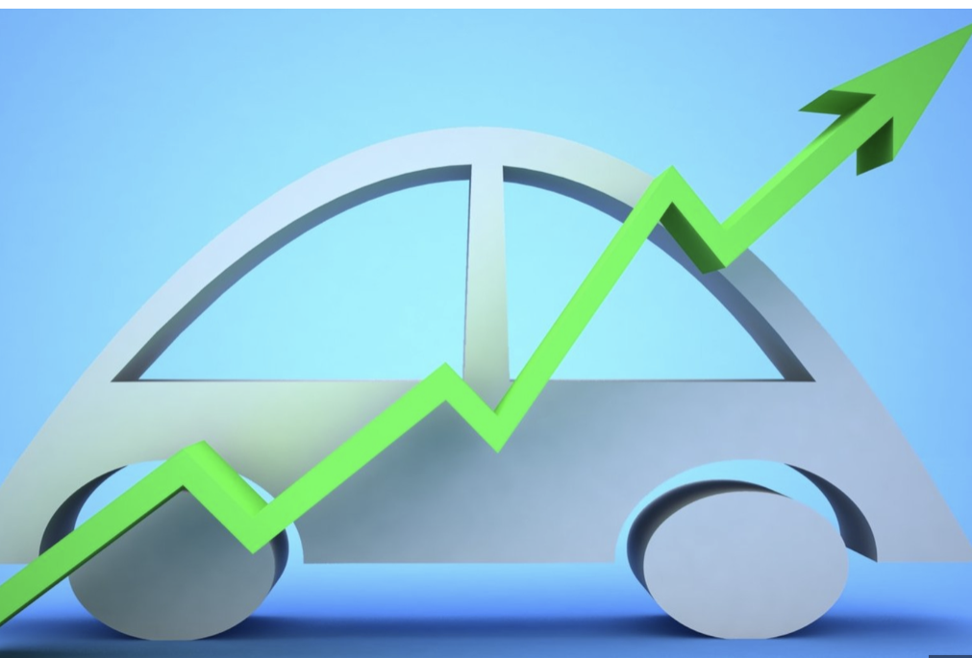
Overview
The goal of our project is to develop a web app that leverages machine learning to predict car prices. The web app aims to empower consumers with data-driven insights, assisting them in making informed decisions when buying or selling cars.

Slide 3
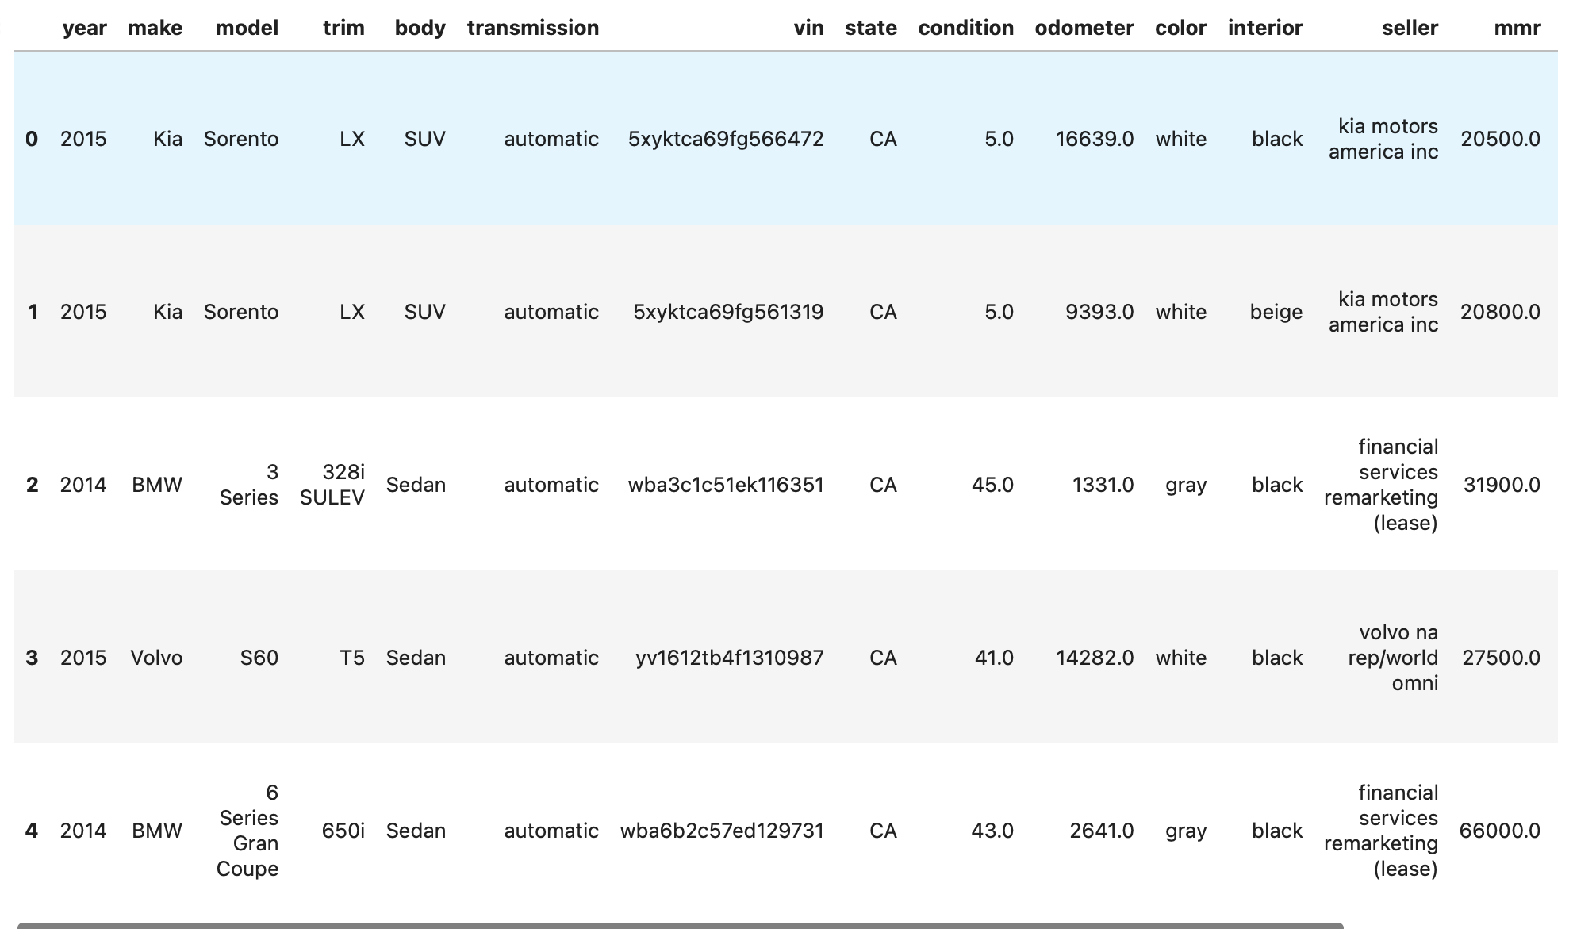
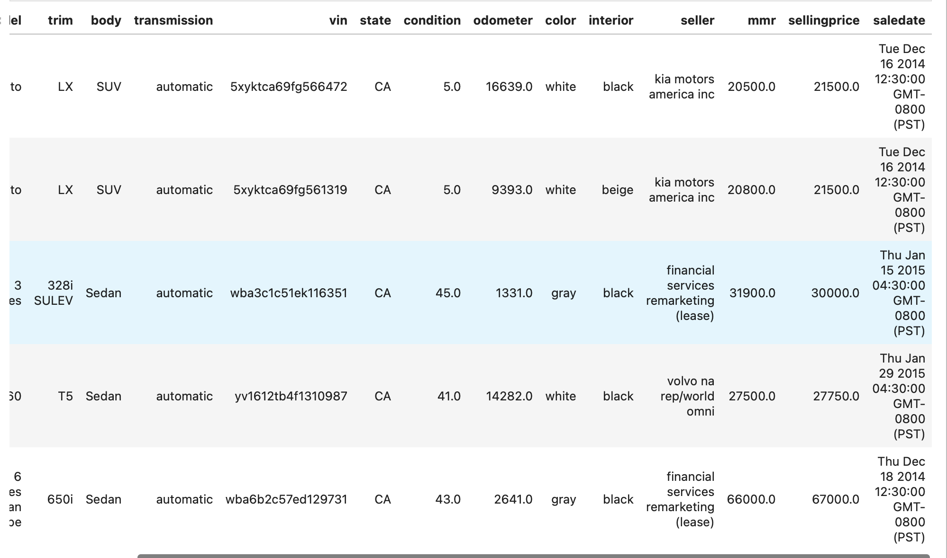
About the dataset
Variables
-Year -Vin -Body
-Make -State
-Model -Condition
-Trim -Odometer
-Color -Interior
-Seller -Sellingprice
-Mmr -saledate
Target Variable = Sellingprice
Data Source:
https://www.kaggle.com/datasets/syedanwarafridi/vehicle-sales-data

Slide 4
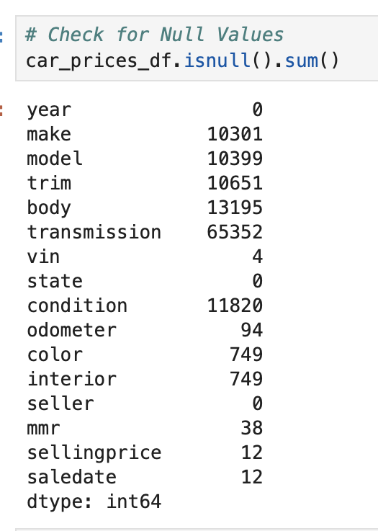
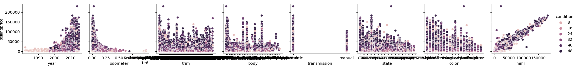
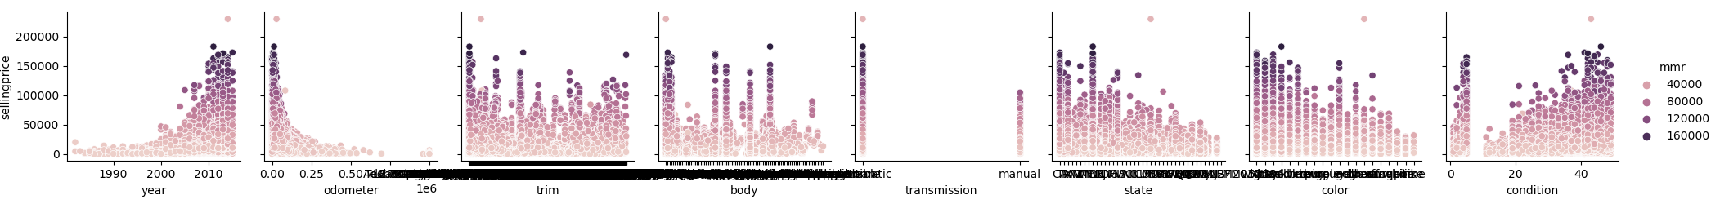
EXPLORATORY DATA ANALYSIS

Slide 5
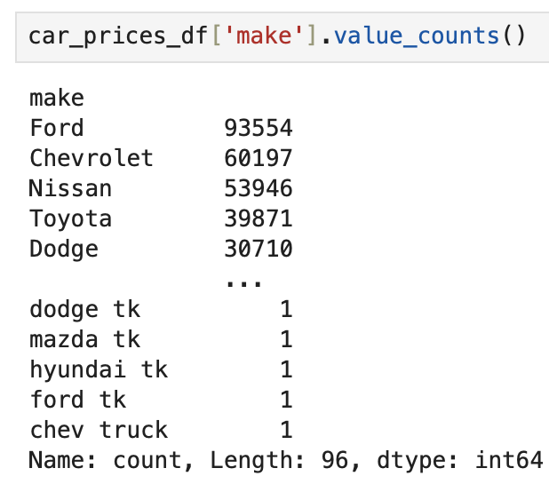
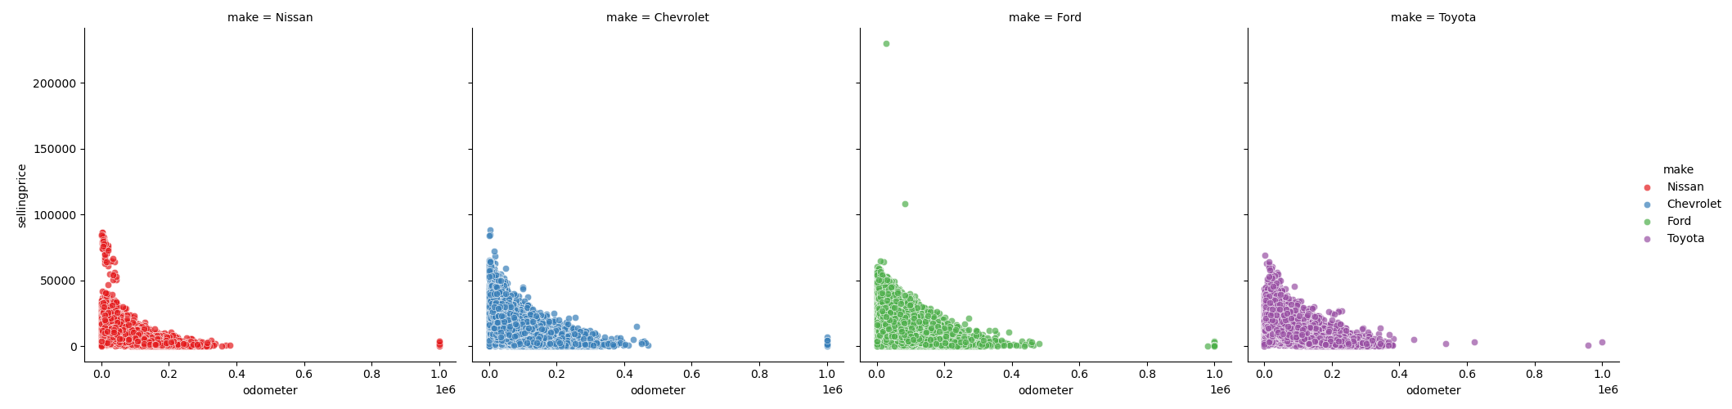
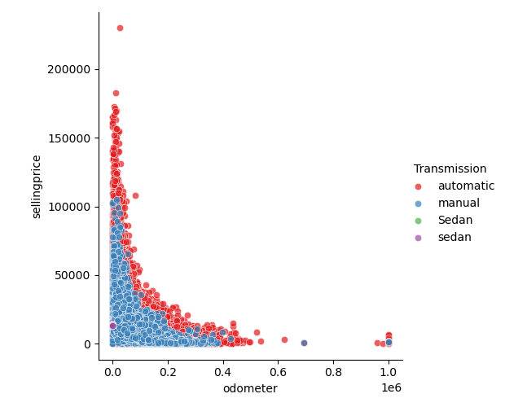
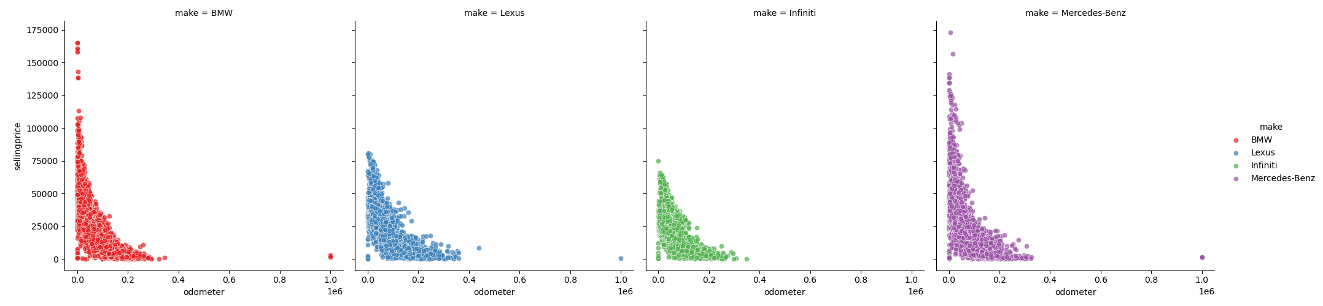
Exploratory Data Analysis continued
Non-Luxury Cars
Luxury Cars

Slide 6
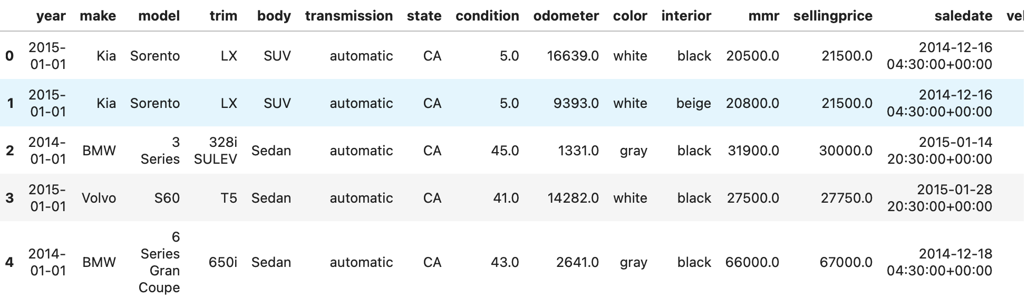
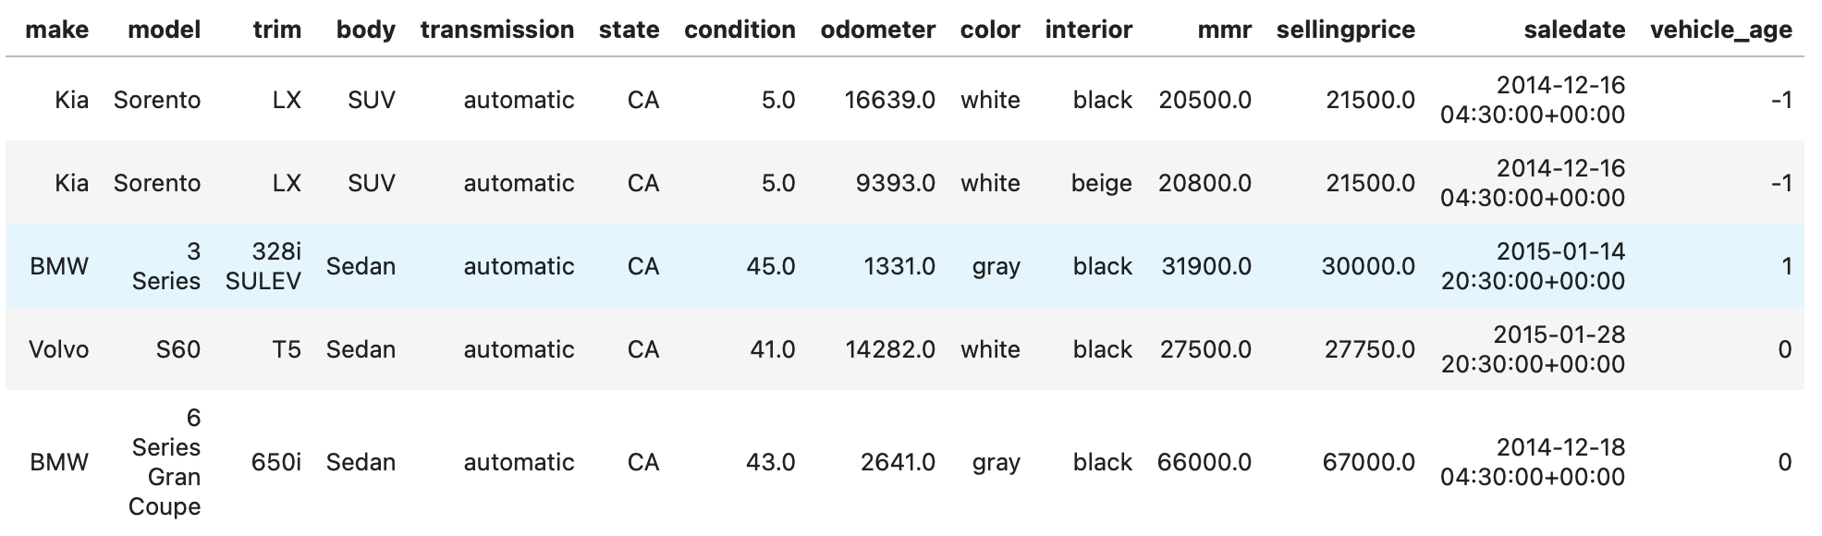
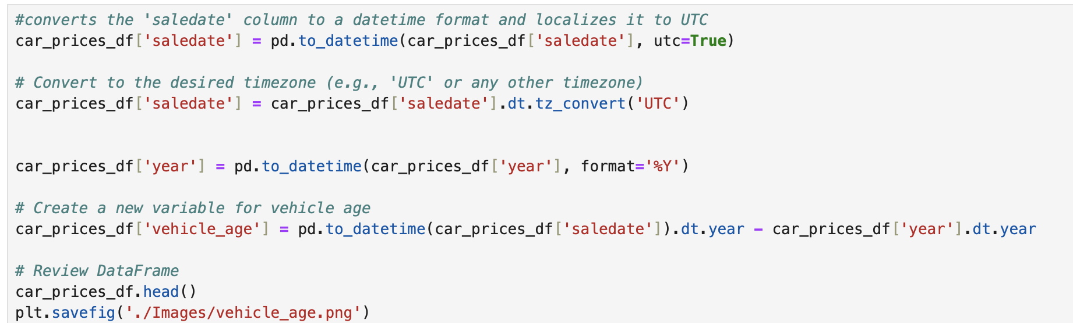
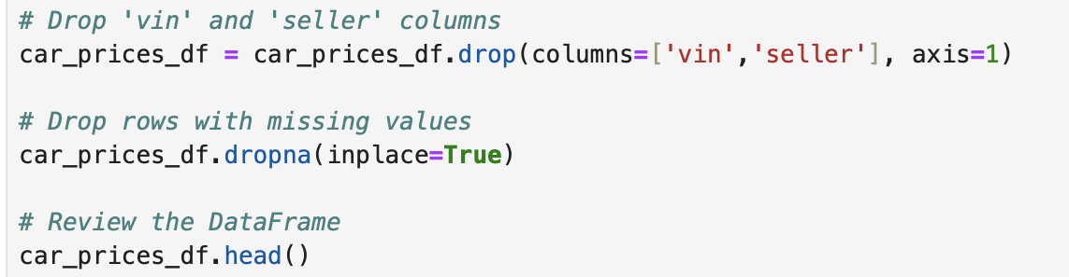
PREPROCESSING

Slide 7
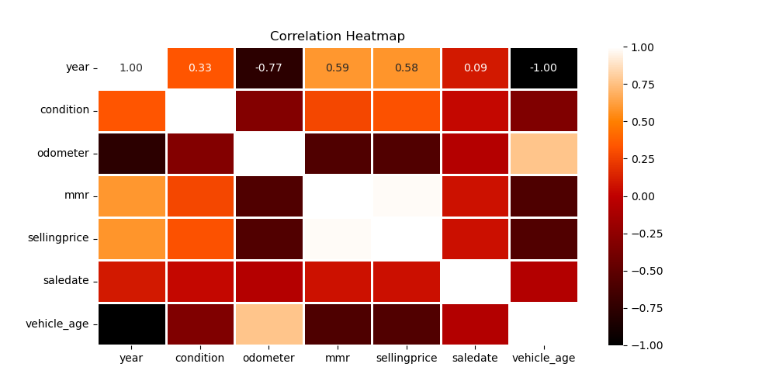
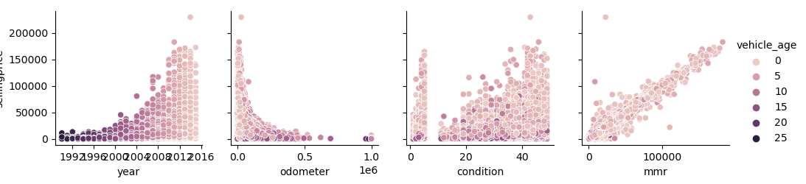
Preprocessing CONT.

Slide 8
Machine Learning
Principal Component Analysis
Explained Variance Ratio
First Principal Component (PC1): 96.37%
Second Principal Component (PC2): 3.58%
Third Principal Component (PC3): 0.05%
Fourth Principal Component (PC4): 0.0005%
Fifth Principal Component (PC5): 0.000005%
Sixth Principal Component (PC6): 0.0000000526%
Seventh Principal Component (PC7): 0.0000000387%
Eighth Principal Component (PC8): 0.0000000158%
Ninth Principal Component (PC9): 0.00000000668%
Lasso Regression
Mean Absolute Error:
1030.0036412381942
R2 score: 0.9662719462364295
Linear Regression
Mean Absolute Error: 1030.003265618789
R2 score: 0.966272087314783

Slide 9
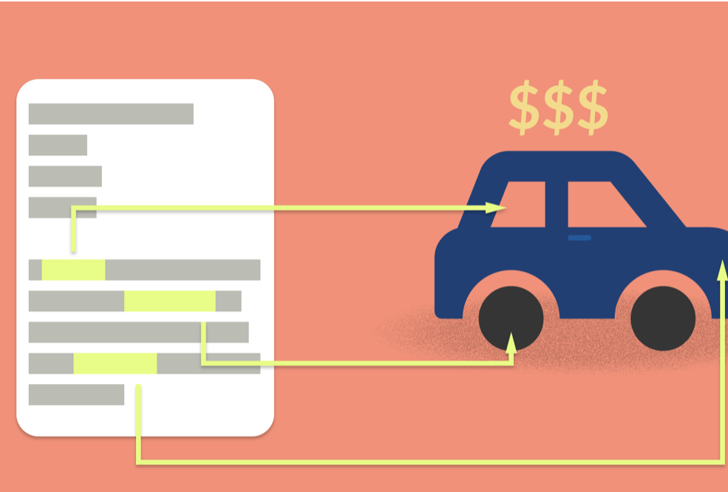
Let’s go check out the web app

Slide 10

Possible future development
We can use feature importance to add/remove variables to will enhance the model accuracy.
We can investigate the impact of the "seller" variable on the variation in selling prices across different car models.
Look into the state variable and see how different models sell in each state. Are some states more expensive? Can you buy/sell the same model for a better price in certain states?

Slide 11

Thank you
Any Questions?

